Slide 1
R programming
It has become one of the best data analytics tools especially when it comes for visual analytics.
A great community contribution makes it easier to learn, use and share for the effective visualization.
It is imperative to say that proper visualization is a very important factor for data scientists & AI specialists.
Even if you are only interested to work with business communication with impactful visualizations, R can provide you a comprehensive way of work where you have full freedom to play with your data and create useful graphs for your audiences. It is an open-sourced tool by the way.
RStudio is the most favorable IDE(Integrated Development Environment) for R.

Slide 2
R is a popular open-source programming language for statistical computing and data analysis. R typically includes a command-line interface. R supports not only branching and looping but also modular programming via functions. To boost efficiency, R can be integrated with procedures written in C, C++, .Net, Python, and FORTRAN.
For data analysis, R programming is a scripting language that supports a number of statistical analysis methods, machine learning models, and graphical visualizations.
It is an open-source programming language with a sizable user base. Learning and using the R programming language is easy. You can build an effective R program, data models, and graphical charts using a variety of built-in functions and support packages. In the modern world, data analysts, statisticians, and marketers frequently use R as a tool for accessing, cleaning, and presenting data.

Slide 3
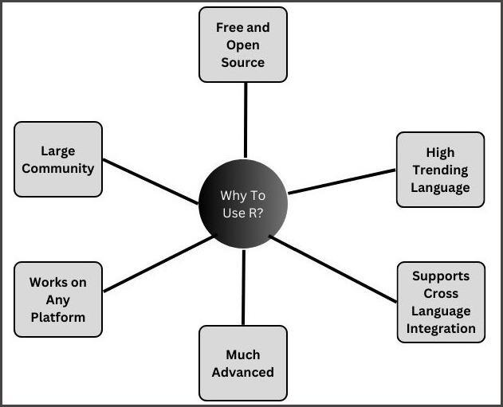
Why R is used

Slide 4
ggplot2
ggplot2 is the most popular data visualization package in the R community.
It was implemented based on Leland Wilkinson’s Grammar of Graphics — a general scheme for data visualization which breaks up graphs into semantic components such as scales and layers.
While using ggplot2, you provide the data, call specific function, map your desired variables to aesthetics, define graphical arguments.

Slide 5
tidyverse
tidyverse is a collecttion of packages for data science introduced by the same Hadley Wickham. ‘tidyverse’ encapsulates the ‘ggplot2’ along with other packages for data wrangling and data discoveries.

Slide 6
Install Packages
If you install tidyverse, then you do not need to install ggplot2 separately!
# install.packages('ggplot2')
install.packages('tidyverse')
install.packages("ggalt")
install.packages('GGally')
install.packages('ggridges')

Slide 7
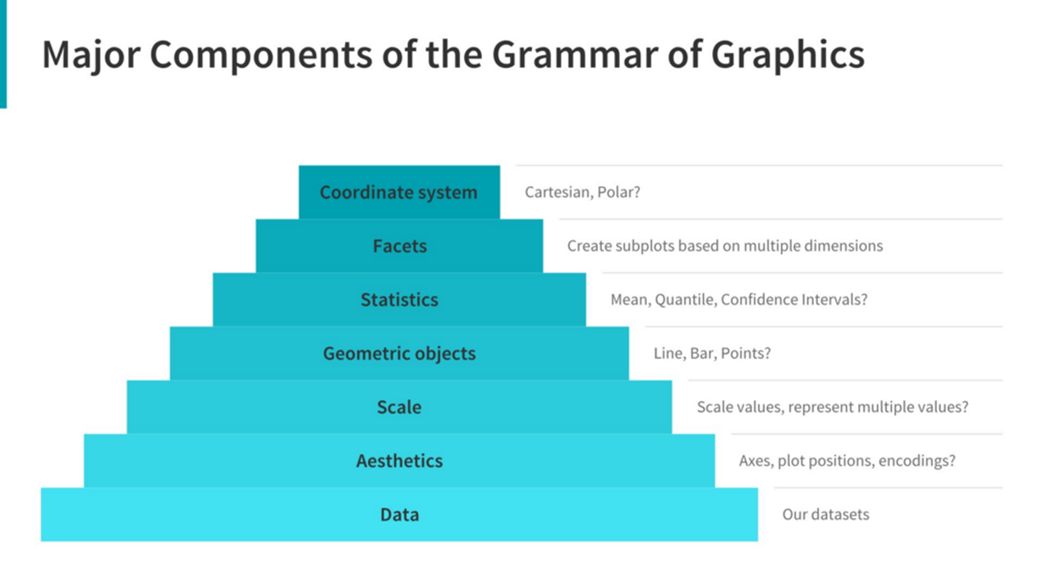
How ggplot2 works:
The Grammar of Graphics Stemming from Leland Wilkinson's Grammar of Graphics, building plots with ggplot follows a very structured framework where different components stack upon each other to form our final graph.

Slide 8
Moving from most to least essential, the components which make up a graph are:
Data: In order to plot something, we need to have the underlying dataset!
Aesthetics: Here we specify how we want our data to map onto our plot. Which variable belongs on the x-axis? What about the y-axis? Are we going to convey additional dimensions of data with colour, or shape, or opacity?
Scale: When setting scales, we need to allow for easy data visualisation. Most of the time we'll use a linear scale, but can also use other options such as geometric, or logarithmic, if the data is distributed differently and would better suit these transformations.
Geometric Objects: These are the way that the data is represented on our graphs (think points, lines, bars, etc..) In ggplot, the name is frequently shortened to geom.
Statistics: We also need to think about summarising our data. Sure, we could plot everything if we want to, but often that will leave a resulting graph cluttered and confusing, particulary if we want to compare groups that have some overlap or variance.
Facets: Speaking of groups, does ti make sens to plot everything on the one graph, or would smaller subgraphs for data in different categories be a better match?
Coordinate System: This has only come up very rarely for me, but ggplot has the capacities to plot onto coordinates that aren't just an x-y plane, for all you pie chart lovers out there.

Slide 9
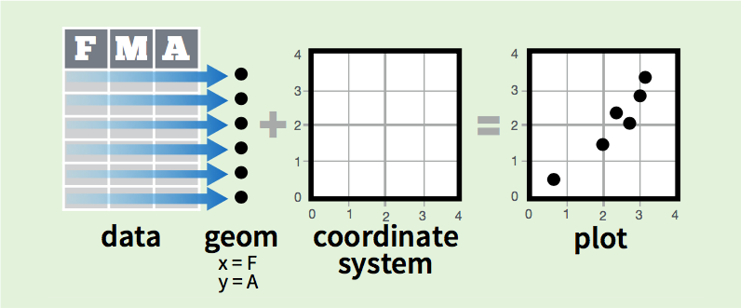
In practice, we can put these elements together a little like this:

